Slide 1
Employee Financial Wellness
Presented by
Blaire MacNeil, MBA, CPA, CMA, CIRP, LIT

Slide 2
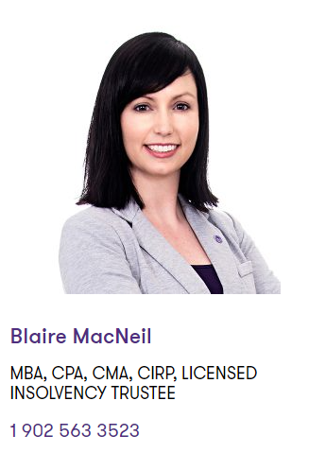
Our Presenter

Slide 3
About Grant Thornton
Grant Thornton is a leading Canadian accounting and business advisory firm providing audit, tax and advisory services—locally and across Canada to dynamic privately owned, publicly listed and public sector organizations.
Offices located throughout Nova Scotia, PEI and New Brunswick and across Canada.
Office in Bridgewater
Notes:
Intro VBM

Slide 4
Financial wellness is…
“Every financial worry you want to banish and financial dream you want to achieve comes from taking tiny steps today that put you on a path toward your goals”
-Suze Orman
Definition:
Being able to meet current and ongoing financial needs; feeling secure about your financial future and being free to make choice that allow you to enjoy life.

Slide 5
Why are we talking about Financial Wellness?
It’s a vital part of a person’s well-being
Financial stress can have a significant effect on employees which effects the employer.
Competitive landscape for attracting talent
Employees are looking to their employers for help - engagement
70% of employees feel their employer should support employee financial well-being
84% of employees would be interested in financial education programs in the workplace
Notes:
Intro VBM

Slide 6
Facts about employee debt:
61% of employees cited finances as their #1 stressor
46% of employees survey said their financial stress impacted their performance at work
45% find their current debt load “overwhelming”
50% of Canadians live pay cheque to pay cheque
48% would find it hard to meet financial obligations if their pay was delayed 1 week

Slide 7
Why is this important to an Employer?
Investing in this can result in:
Higher Productivity
Lower absenteeism/Presenteeism
Attracting an retaining talent
Employees retires when expected
Improved morale
Better use and appreciation of employee benefits and retirement savings

Slide 8
Impacts of Financial Stress on Employees

Slide 9
Sources of financial stress
The top five reasons people experienced financial stress in 2019 were:
loss of income – 37%
medical reasons – 23%
relationship breakdown – 15%
business failure – 7%
tax liabilities – 6%

Slide 10
Signs of financial difficulty
Does this describe your employees?
Considered or has taken a payday loan | In the overdraft every month
Receiving collection calls | Robbing Peter to pay Paul
Being charged NSF fees regularly | Always looking for overtime or extra shifts
Just “can’t get ahead” | Fights with spouse/partner about money
Seem to have one crisis after another | Presenteeism and absenteeism
Feeling overwhelmed | Seeking out a quick fix

Slide 11
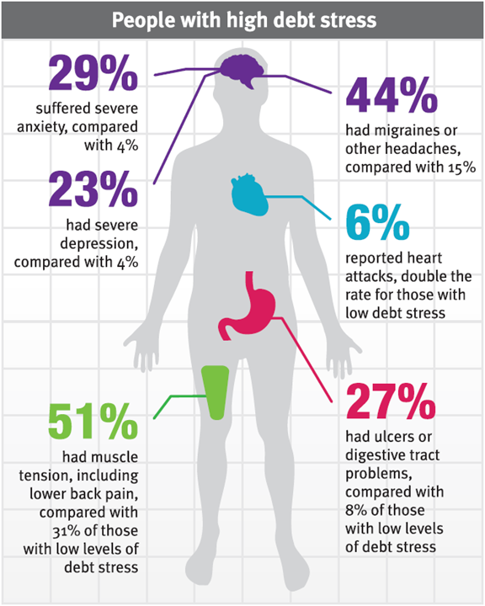
Financial stress can lead to:
Physical and mental health issues
Twice as likely to report overall poor health
Four times as likely to suffer sleep problems, headaches and other illness

Slide 12
Financial stress can lead to:
Stress at work
Something employees can not leave at home
Affects morale and interpersonal relationships
½ of Canadian admit it affects their performance at work.
One study found that finically stressed employees are 5 times likely to be distracted at work and 46% spent more than 3.5 hours of work time deal with financial issues.

Slide 13
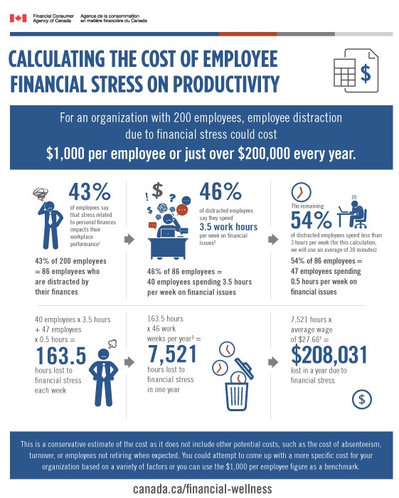

Slide 14
Financial stress can lead to:
The cost to employers:
Administrative and financial errors
More workplace accidents
Production errors
Poor customer service

Slide 15
Supporting Your Employee’s Financial Wellness

Slide 16
How do I support my employees financial wellness?
The first step is to find out what your employees need?
Consider demographics
Age - years to retirement
Role
Family situation
Ask them!
Simple conversations
Surveys
Focus groups (larger organizations)

Slide 17
How do I support my employees financial wellness?
Develop a plan
Start small
Do you have the capability in house to deliver on the feedback you received?
Take advantage of free resources
Are you already offering some facet in the form of an EAP program
Promotion of internal programs

Slide 18
Information that is often covered in support programs
Financial Literacy
Budgeting
Debt management
Credit score education
Goal setting
Savings and investing
Retirement planning

Slide 19
Ways to deliver information
EAP Programs
Take advantage of free guest speakers
Use online resources
Create a physical library of materials
Professionals cards (referrals)
Offer one on one counselling
Talk to each other!
Remember: accessibility to information must be easy.

Slide 20
Professional help
Who can help you?
Professionals in financial roles if No EAP exists
Financial planners
Bankers
Mortgage brokers
Tax professionals
Licensed Insolvency Trustees
Our counselling background

Slide 21
Resources

Slide 22
Helpful resources
Our website:
www.gtdebtsolutions.com
Follow us on social media:
Twitter: @GTDebtRelief
www.facebook.com/GrantThorntonLimited
Credit bureaus:
www.equifax.ca
www.transunion.ca
The Financial Consumer Agency of Canada
www.canada.ca/en/financial-consumer-agency.html

Slide 23
Questions?
Thank you for having us!

