Slide 1
Never, EVER, Do This!!!
The definition of Brand: a class of goods identified by name as the product of a single firm or manufacturer, the Merriam-Webster dictionary.
Or, a person’s gut feeling about a product, service or organization.
Marty Neumeier
The definition of Brand Identity: is the collection of all elements that a company creates to portray the right image to its consumer
The definition of Brand Image: the feeling about your Brand held by potential clients
The definition of Brand Strategy: An action plan to take your Brand to your ideal customer.
Or, a plan for systematic development of a brand to meet business objectives.
So what does all this actually mean when broken down to its simplest form?

Slide 2
The First Step is Always
WHY

Slide 3
Brand- You Don’t Control It
Brand –More than
The first Impression
Why will your clients care?
Why did you start the company?
What in your company is bigger than your product?
Let’s talk shoes.
People respond to passion. They like knowing that a business is run by people who care deeply about an issue that matters, even if that issue isn’t generally on their radar.
Josh Levs

Slide 4
Gathering The Tribe
Taking the time to explore the path that led to your business allows us to succinctly develop the founder’s vision, the WHY of the business.
That leads to the company core values, ethos, non-negotiables, culture, and legacy.
And that, is what people care about more than your features, benefits, or products.

Slide 5
What does your Brand Promise
Visual Identity is one thing
But, tone of voice and personality
of your Brand is another
Think of a Brand as a person,
The Brand Persona
Think of the process as a long-term
relationship between the Brand and the
Client.
For example: You wouldn't go
to a networking event and
just stand there and look good.
If you think it includes faster, cheaper, better, etc. that would be a problem.
Those are benefits of the product, but not the core of the brand.
Brand is “the gut feeling people have about your company”

Slide 6
The goal is to shape your audience's perception
of your brand so ultimately, you can
influence them.
So, now we can start to develop both the verbal and visual language we will need to help start that perception shaping journey.

Slide 7
Can you articulate your company values right now? Can your employees? Clients? Every company has values and culture, articulated or not. You cannot CREATE values. You look inside and decide on the beliefs you already hold.
Your Values

Slide 8
Values are Verbs
Values are verbs
Values are actionable
So, are the words above values?
Like honesty. Am I honesting right now?
But., is ”always tell the truth” more human?
More actionable?

Slide 9
Brand Strategy Grid
Brand Core
Brand Positioning
Brand Persona
Purpose Statement Results | Audience Needs And Desires | Brand Personality Exercise Results
Vision Statement Results | Market Analysis and Positioning Exercise Results | Your Brand’s Tone of Voice How you communicate with your customer
Top Three Company Values | Awareness Goals to Help Prioritize Job Scope | Two Potential Tagline Options
Purpose
Vision
Values
Thanks to:
Arek Dvornechuck
Brand Strategy Genius

Slide 10
Brand Strategy
The Foundation of your company
Here is a great Question
How Might We?

Slide 11
How Might We?
Impact our clients? Ensure that our brand is lifechanging.
Inject emotion? Ensure that our clients LOVE our brand.
Encourage loyalty? Ensure that our clients connect with the brand and not just the offering.

Slide 12
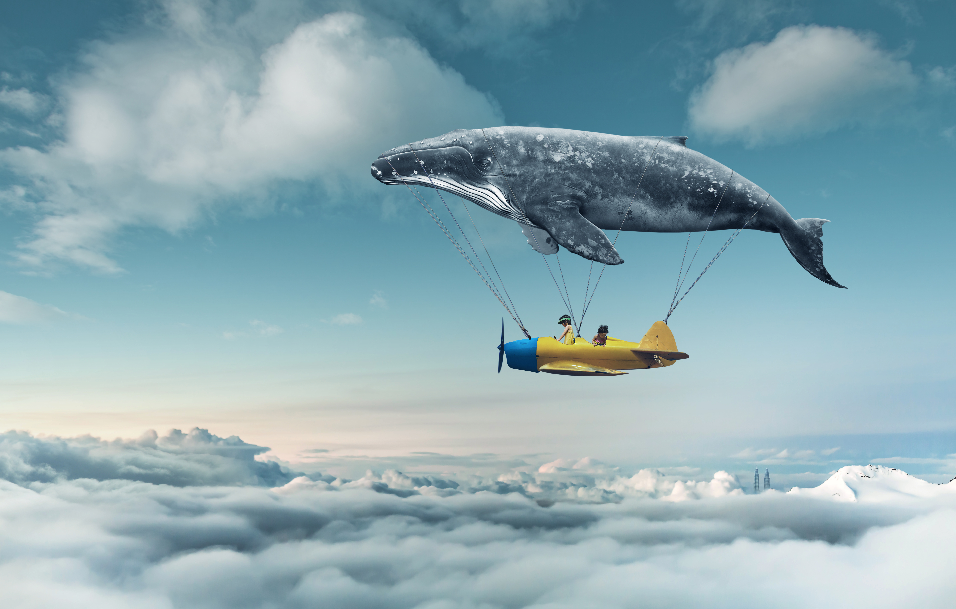
Let’s Chat about our Brand
Strategy Workshops
Brian@directadfactory.com
902.521.0441
No Boundaries

